Slide 1

Amazon Web Services
workshop
for System Engineer
Amazon Web Services Use Cases

Slide 2
Topics
Use Case: Web, Mobile and Social Applications
Traditional VS Amazon Web Services
Web Architecture, Security Groups, Route 53, Elastic Load Balancer, Database, and Availability Zones.
More Use Cases
AWS Products and Services Reviews.

Slide 3

Use Case:
Web, Mobile and Social Applications
Whether you’re running for company’s website, hosting content management system, deploying social media apps, or just creating an internal Sharepoint site, hosting your website on AWS is fast, easy, and low cost.
Deploy an maintain applications that always run fast.
Meet demands of millions of new users.
Deploy 1000s of computing instances in minutes.
Compatible with all devices.
Platform agnostic.

Slide 4
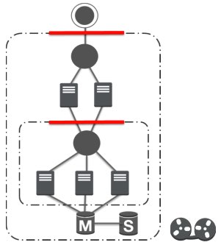
Traditional Web Architecture
App Server Tier
Fleet of machines handling application specific workloads, caching server machines can be implemented at this layers.
Web Load Balancer
Hardware or software solution to distribute traffic over we servers.
Web Tier
Fleet of machines handling HTTP requests.
Data Tier
Database server machines with master and local running separately. Network storage for static objects.
App Load Balancer
Hardware or software solution to spread traffic over app servers
Backend Firewall
Limits access to application tied from web tier.
Backend on Tapes
Periodic backups stored on Tapes usually managed by 3rd party at their site.

Slide 5

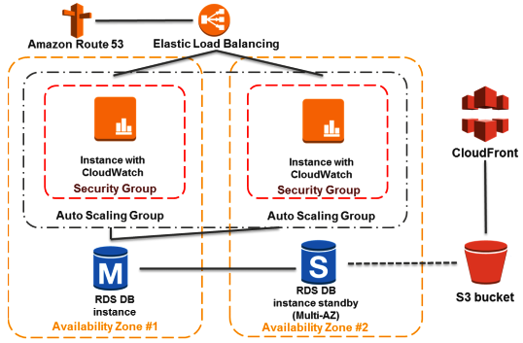
AWS Web Architecture
Amazon EC2 instances run the applications and web servers and belong to an security group.
The Elastic Load Balancer is associated with the Auto Scaling group to ensure the traffic is distributed evenly among the Amazon EC2 instances.
The Security Group acts as an exterior firewall for the Amazon EC2 instances.
The database tier consists of Amazon RDS database instances located in multiple AZs for failover protection. RDS provides automated backup to Amazon S3.
An Auto Scaling group is used to maintain Amazon EC2 instances. This Auto Scaling group spans over multiple Availability Zones to protect against potential failures if an AZ becomes unavailable.
Users may be globally distributed or a lots of users may visit the site at one time, high volume static content is edge cached for better performance by Amazon CloudFront.

Slide 6

Websites on AWS: Elasticity / On-Demand
The hardware costs of building out a traditional hosting environment for a production web application don’t stop with the production fleet.
Test
In the AWS cloud, you can provision testing fleets only when you need them.
Beta
Simulate user traffic on the AWS cloud during load testing in a beta environment.
Pre-Production
Use parallel fleets as a staging environment for a new production release.
Quick switchover from current production to a new application version with little or no service outages.

Slide 7
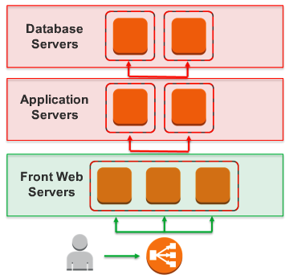
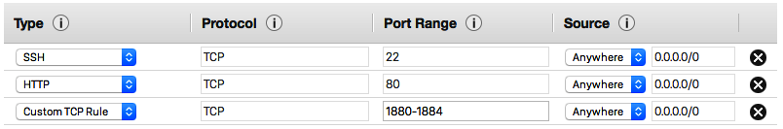
Security Groups
Traditional Web Infrastructure Firewall at the edge.
AWS Web Infrastructure Security Groups - Security at the host level
Security groups are analogous to an inbound network firewall, for which you specify the protocols. ports, and source IP ranges that are allowed to reach your EC2 instances.

Slide 8
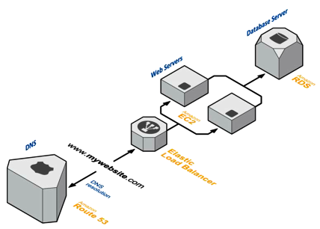
Manage Public DNS with Amazon Route 53
Query for your domain are automatically routed to the nearest DNS server and thus are answered with the best possible performance.
Route 53 resolved requests for your domain name to your Elastic Load Balancer, as well as your zone apex record

Slide 9
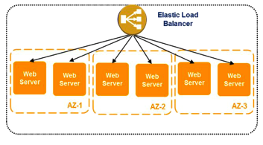
Elasticity with Elastic Load Balancer
AWS provides this capability through the Elastic Load Balancing service, a configurable load balancing solution that supports:
Health checks on hosts
Distribution on traffic to EC2 instances across multiple availability zones.
Dynamic addition and removal of Amazon EC2 hosts from the load-balancing rotation.

Slide 10
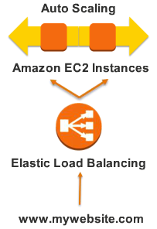
Elasticity with Elastic Load Balancer
Dynamically grow and shrink the load-balancing capacity to adjust to traffic demands while providing a predictable entry point by using a persistent CNAME.
If your application requires more advanced load-balancing capabilities you could run a software load-balancing package on EC2 instances. You could then assign Elastic IP addresses to those load-balancing EC2 instances in order to minimise DNS changes.

Slide 11
Hosted Databases
Many web applications contain some form of persistence, usually in the form of a relational or NoSQL database. AWS offers both relational and NoSQL database infrastructure.
Alternatively, you can deploy your own database software on an Amazon EC2 instance.
 | Relational Database Solutions | NoSQL Solutions
Managed Database Service | AWS Relational Database Service (RDS) - MySQL, Oracle, SQL Server | Amazon DynomoDB
Self-Managed | Hosting a relational DBMS on an Amazon EC2 instance. | Hosting a NoSQL solution on Amazon EC2 instance.

Slide 12
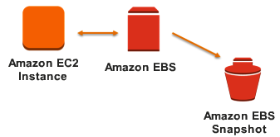
Hosted Database: Self-Managed
You can install your choice of RDBMS on an EC2 instance and manage it yourself, just you would like on-premises.
AWS recommended that database running on Amazon EC2 utilize Amazon Elastic Block Storage (EBS) volumes, which are similar to network-attached storage (NAS). These will remain available even if the host fails.

Slide 13
Example Storage Solutions
Data to Store | Storage Solution
Static resources, such as logs, images, scripts, and style sheets. | Non-critical, short-lifespan resources can be stored on local ephemeral storage. Use Amazon S3 for durable storage.
Dynamically generated content (PHP, ASPX, etc.) | Deployed on the Amazon EC2 instance that is running the site.
User data | Amazon RDS
Session data | Amazon DynamoDB
Database files | EBS volumns
Shared storage | Stored in a distributed or network file system like Gluster FS or NFS.

Slide 14
Scalability with Auto Scaling
For example: The application server auto-scaling group might scale out and in according to CPU utilization.
Whereas: The web servers auto-scaling group might trigger scaling out and in, in response to changes in network I/O.

Slide 15
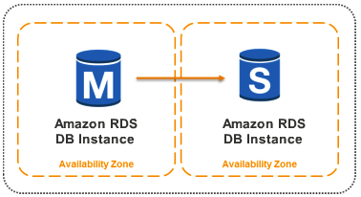
Redundancy with Multi-AZ Deployments
Availability Zones give you easy access to redundancy deployment locations. Physically district locations that are engineered to be insulated from failures in other AZs.
It is important to ensure that there are provisions for migrating single points of access across Availability Zones in the case of failure. For example, a database slave should be set up in a second Availability Zone so that the persistence of data remains.

Slide 16
Another Use Cases
Digital Marketing & Media :-
Run your marketing campaigns, apps, and websites in the cloud.
Ingest, store, encode, protect, and stream medias.
Case Study :- Public Broadcasting Service (PBS), uses AWS CloudFront reliability, migrate content (1PB/month streaming) to Amazon S3.
Big Data and High Performance Computing :-
Amazon Elastic Map-Reduce ingests data from Amazon S3, stream data from Amazon Kinesis to Amazon EMR for processing, launch EC2 instances to process the data parallel.
Backup, Archive, and Disaster Recovery :-
Backup data from on-premise or data center and upload to backup on Amazon S3 with secured Amazon Direct Connect, then archive data to low-cost storage Amazon Glacier.
And more…

Slide 17
Conclusion
Easy deploy and maintain apps that always run fast.
Set of secure and on-demand storage, archive, computing, transcoding, streaming, and application services for media companies.
Customers can install and configure their own applications or lunch entire software stacks from Oracle, SAP, Microsoft and IBM in minutes by choosing pre-configured Amazon Machine Images (AMIs), or virtual machines.
Business can use AWS scalable infrastructure solutions to cost-effectively store, mine, manipulate, and analysis large datasets.
Business can leverage the storage capabilities of the AWS Cloud to store and manage growing volumes of data.

Slide 18












Labs Architecture
Security Group for ELB
Route 53
Elastic Load Balancer
CloudFront
EC2 for NAT
EC2 with Node-RED
EC2 with Node-RED
EC2 with MongoDB
EBS Volume (MongoDB Data)
Auto Scaling Group
S3
VPC: Private Subnet
VPC: Public Subnet
AMI (Snapshot)
Launch Configuration

Slide 19
Reviews
To help customers archive a global presence, AWS lets you place your applications in which of the following infrastructure pieces around the world?
AWS Regions
Edge Locations
Amazon S3 Buckets
Amazon CloudFront
Notes:
(1)

Slide 20
Reviews
What does an AWS Region consist of?
A console that gives you a quick, global picture of your cloud computing environment.
A collection of databases that can only be accessed from a specific geographic region.
An independent collection of AWS computing resources on a defined geography.
District locations within a geographic area designed to automatically replicate and backup data.
Content distribution network, which is used to distribute content to users.
Notes:
(3)

Slide 21
Reviews
Which of the following are Database services? (Select all that apply.)
Amazon Relational Database Service
Amazon NoSQL
Amazon DynamoDB
Amazon Redshift
None of the above
Notes:
(1,3,4)

Slide 22
Reviews
Which statement best describes Availability Zones?
Content distribution network which is used to distribute content to users
District locations within and AWS Region that are engineered to be isolated from failures or low latency.
A restricted area designed specifically for creating Virtual Private Clouds.
Two zones containing compute resources that are designed to maintain synchronised copies of data between each other.
Notes:
(2)

Slide 23
Reviews
Which of the following are Networking services? (Select all that apply.)
Amazon Route 53
Amazon CIDR
Amazon Virtual Private Cloud
Amazon Firewall
Amazon CloudFront
Notes:
(1,3)

Slide 24
Reviews
Which of the following are Compute services? (Select all that apply.)
Amazon Elastic Compute Cloud
Amazon Big Data Processing
Amazon Elastic Load Balancer
Amazon Desktop
Amazon Workspaces
Notes:
(1,5)

Slide 25
Reviews
Which of the following are Application services? (Select all that apply.)
Amazon Simple Application Services
Amazon Simple Email Service
Amazon Simple Queue Service
Amazon API Service
Amazon Workflow Service
Amazon Transcoder
Notes:
(1,2,3,6)

Slide 26
Reviews
With Cloud Computing, you provision the amount of resources you need. If you need more, you can easily case out. If you don’t need them, just turn them off and stop paying.
True
False
Notes:
(true)

